Slide 1
Introduction to Agile Analysis
A module in the
Agile Business Analysis
workshop
This work is licensed under the
Creative Commons Attribution-ShareAlike 4.0 International License.
To view a copy of this license, visit http://creativecommons.org/licenses/by-sa/4.0/.

Slide 2
Topics
Analysis pain points
The Agile approach
Analyst responsibilities & tasks
A shared understanding
Activity

Slide 3
What are your Goals?
What aspects of the business are you responsible for driving? (Business)
How do you contribute to the success of a project? (Project)
How do you want to be treated at work? (Personal)Personal)
Notes:
During this activity the aim is to determine your goals during analysis from a business perspective, a project perspective and a personal perspective.
Identifying these goals will allow us to start thinking about how to achieve them.
Business Goals
Competitive advantage
Product to market
Compliance
Project Goals
Identify requirements
Produce software
Personal Goals
Respect
Build better working relationships
Open communication

Slide 4
What are your pain points?
What pain points are you facing, or have you faced in the past, when trying to achieve the goals of an analyst?
Notes:
Whether you are working on an agile or traditional project your responsibilities, goals and expectations are quite similar.
During a project we are often confronted with obstacles that may affect the achievement of our goals. Let’s determine what some of these obstacles may be during the next activity.
Just have folks call them out and write them on a white board or easel paper.

Slide 5

Analysis Pain Points
Change
Cost
Accommodation
Business value
Not ideal solution
Frustration
Lack of clarity
Team communication
Tons of paperwork
Notes:
Frequent change requests from the customer should be allowed and encouraged, but handled properly.
With traditional methodologies we can’t focus on business value as well as when we get customer feedback frequently and respond.
We can develop a solution that fits the business need when we regularly provide working software for the business to test-drive.
Everyone is frustrated with long requirements documents.
Do we truly understand what the business needs? How can we when they actually don’t either until they see it.
Siloed roles and processes causes a reluctance to communicate.

Slide 6
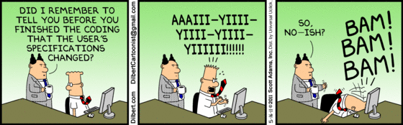

Slide 7
The Agile Approach

Slide 8
Manifesto for Agile Software Development
We are uncovering better ways of developing software by doing it and helping others to do it. Through this work we have come to value:
Interactions and interactions over processes and tools
Working software over comprehensive documentation
Customer collaboration over contract negotiation
Responding to change over following a plan
That is, while there is value in the items on the right, we value the items on the left more.
www.AgileManifesto.org
Notes:
Remember the values stated by the 17 individuals at that ski resort in Utah.
Comprehensive documentation – we’ll discuss some of the artifacts that may be produced. Just enough.
Requirements are not contracts – they are initiations of conversations.
The plan we create will change. So we do just enough analysis to understand the concepts and know what we don’t know.

Slide 9
Agile Takes A Different Approach
Avoid “big upfront design” in favor of:
Just enough upfront design!
Helpful practices
Notes:
Recognize that: you will not create a perfect plan, no matter how much time you spend on it upfront
So do just enough to:
Develop a shared vision with your stakeholders
Create a list of valuable features
Understand the prioritization and relative sizing of those features
Work out a candidate architecture (not detailed design)
Craft a plan that identifies the Minimal Marketable Features
And agree with your stakeholders that you will work together to stay within the parameters of that plan

Slide 10
Agile Practices
Frustration
Cost
Team Communication
Short
Releases
Automated
Build/Deploy
Short
Releases
Pair
Programming
IKO/IPM
Retrospectives
IKO/IPM
Retrospectives
Automated
Testing
Card Wall
Refactoring
Daily
Stand-ups
Collective
Ownership
Card Wall
Daily
Stand-ups
Lack of Clarity
Team Communication
Simple Design
Coding
Standards
Velocity
Metrics
Iterations
Iterations
Co-location
Co-location
Test Driven
Development
Change
Team Communication
User
Stories
Sustainable
Pace
User
Stories
Sustainable
Pace
On-site
Customer
Continuous
Integration
On-site
Customer
INDIVIDUAL
Frustration
Tons of paperwork
TEAM
Business Value
ORGANIZATIONAL
Notes:
Ask if they remember this slide from Fundamentals – Planning the Project
Ask them to call out practices that may help alleviate some of the pains we just talked about.
[CLICK] Then show results
[CLICK] for each call out
Client examples
Company 1 – saved them money by allowing them to make a painful decision earlier
Company 2 (heard at an Agile group meeting) – business felt that showcases were like Christmas – being able to see the features come to life each iteration was like receiving gifts compared to their previous waterfall process

Slide 11
Lifecycle of an Agile Project
Inception
Development
Vision
High Level Stories
Initial Release Plan
Updated Release Plan
Updated Release Plan
Release 1
$
Updated Release Plan
Release 2
$
Release 3
$
Notes:
There is planning and a go/no go decision
Get enough information to do that
Inception phase
Solution definition
Acknowledges change will happen
Know what you don’t know
Detail out the 1st release only
2-4 weeks for a 6 – 8 month release
--------------------------------------------------------------------------------------------------
Contrary to what most people think about Agile, there is planning. We call the initial planning the Inception phase, Initiation phase (I’m still confused as to what is what). Bottom line is an initial Release Plan with estimates and timelines needs to be created.
This can then be used to determine if the organization will proceed with the project. Does the business case support it?
Planning continues throughout the project.
Getting the Inception phase right will increase the chances of success of a project. Knowing what you are building and about how long it will take is helpful.
That doesn’t imply that things will not change. It only implies that you’ve set the right direction and have a generally complete view of the desired outcome. You also know what you don’t know. If you have multiple releases planned, you may not get into detail for Release 3 at the beginning. You may also know that there is some analysis risk on some of the stories scheduled for Release 1.
Then there is Development.
Rule of thumb – 2-4 weeks inception for 6-8 months development.
Let’s see how analysis fits into Agile projects!

Slide 12
Analysis Project Lifecycle
Concept / Inception
Develop & Deploy
Inception
Notes:
The Analysis Project Lifecycle fits nicely into TW project lifecycle.
Remember the phases of Concept, Inception, Develop & Deploy.
These activities is what’s happening during these phases.
Note Concept phase and Inception sometimes overlap.

Slide 13
Agile Analysis Artifacts
Inception
Iterations
Vision
Prioritized business objectives
Roles & personas
Scenarios
Narratives
Story maps
Right-sized stories
Initial story list (Backlog)
Release plan with estimate
Functional test matrix
Notes:
A number of artifacts are created during inception. Typically only 1 during Iterations.
To help get to an initial estimate, release plan
The analyst is key to understanding what needs to be built functionally
There are a number of techniques used to obtain that understanding.
Are all these documents kept up to date? Not unless you discover a large piece missing. A whole scenario missing from the process flow. A role missing or completely off the mark definition.

Slide 14

Relative Sizes of Phases
Initiation
Evolve / Handover (…)
Inception
Develop & deploy
Notes:
There is planning – Inception
2 – 4 weeks for a 4 – 6 month project
Flows, scenarios, stories
We need to prepare for Development – Initiation
Environment(s) set up
Narrative writing
Team processes
Develop & Deploy
Release working software
About 12 weeks of work
Common question?? How do I know how big the project is to determine how much time for Inception?
There has been a ‘Conceptualizing’ phase hopefully.
Experience. Relative sizing to other projects you’ve done.

Slide 15
Models
Narrative
Story #:
Title:
Business Impact:
Scenario
Step 1
Step 2
Business process model
Step 3
Prioritized list
Title: Priority:
As a ……
Story Card
Prototype (lo/mid fi)
Notes:
Define how you will capture the information that you plan to obtain from various sources.
Will it be lite weight, cards, paper
Will it be more sophisticated, software.
What technique will you use for business process modeling?
Start with index cards and stickies
Visio or another tool
How will you capture stories?
Index cards,
Transferred to excel or another tool at some point
What approach, tools will you use for prototyping?
Is there a UX person and will they need to be scheduled?
A context model (often a data flow diagram) showing how your system fits into its overall environment
A high-level business requirements model (often an essential use case model)
A glossary defining critical business terms
A domain model (often a class diagram or data diagram) depicting major business classes or entities
A business process model (often a data flow diagram or activity diagram) depicting a high-level overview of the business process to be supported by your system. This diagram is one level of detail greater than your context diagram
Low: 4min
High: 10min

Slide 16
Making the Right Choice
Agile
Non Agile
Volatile requirements
Stable requirements
Automation
Little Automation
Customer readily available
Customer not accessible
Co-located team
Segregated team
Time to market matters
Fixed scope matters
Notes:
Applying your current skills in a new manner
Applying these skills at different times during the project cycle
New concepts, techniques
All projects are different
Choose your techniques based on the project
Volatile requirements – less detail up front
No test automation – BA kicks in on testing
Customer not accessible – plan and communicate with IM on status
Segregated team – communication tools – IM, skype
Fixed scope – more details up front
------------------------------------------------------------------------------------------------
In Agile Analysis you will be applying your current skills and techniques in a new manner or at different stages in the project lifecycle. You will also be introduced to new concepts that will assist you to accomplish your goals during the project lifecycle.
Highlight to participants that there are projects where the traditional approach may be more suitable. As a business analyst you can make the right choice depending on the project, the domain, the client and their business objectives.
For example, if there is little automated testing, which typically gives the team confidence to make changes, the BA may need to kick in with manual testing to provide that assurance that changes did not break existing code.
If the customers are regularly not accessible, the BA will need to plan effectively and communicate regularly with the IM to make sure the narratives are ready for a kickoff meeting.
Segregated teams will need to utilize tools to keep communication flowing. IM, skype, etc.

Slide 17
Analyst Responsibilities & Tasks

Slide 18










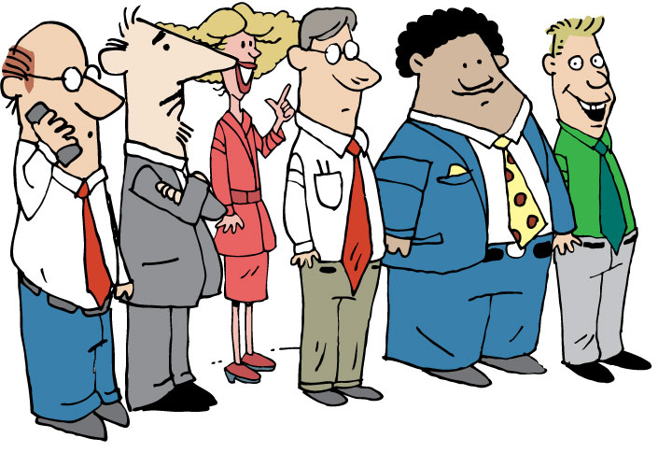



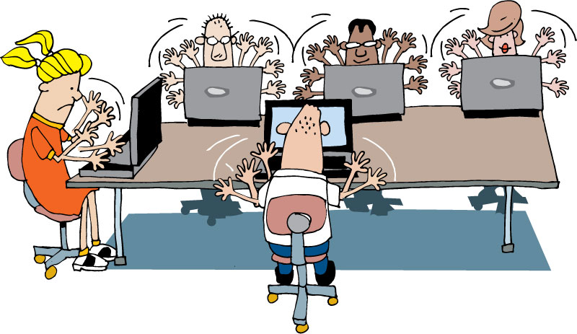


Team Roles & Responsibilities
Extended
team
SME
Security Architect
Project Owner / Sponsor
Agile
Project
Team
Infrastructure Delivery Mgr.
Coach
Product Owner
PM / IM
Core
team
Program Manager
Architect
Tech Lead
Business
Analyst
Project Stakeholder Board
Developer
UX Designer
Tester
Other Business Representatives
Operations, Integration & Support
Database Administrator

Slide 19
Analyst Responsibilities
Business value
Prioritization
Stories
Artifacts
Demos
Notes:
The Business Analyst is responsible for:
Insuring that everything we produce/design/develop provides business value
helping to prioritize their requirements
Writing story cards and all related artefacts that are clear, concise, comprehensible, and that can be turned in to code and tests by the project Team
For demonstrating progress regularly in business showcases

Slide 20
Analysis Tasks
Facilitate
Models
Story card list
Story Narratives
Showcase
Developer support
QA support
Notes:
The BA is responsible for:
Developing process models and related story card list for the release (escalating any changes to initial agreed list as they occur).
Confirmation of business benefit delivery from proposed process before development commences and escalation where there may be areas of concern.
Completion of story narratives (with key stakeholder review) prior to development kickoff
Demo of system development to key stakeholders following development, capturing possible changes, working with business/IM to prioritize those changes
Provision of support to Developers and QA team members during card development and change/implementation teams following sign off to ensure maximum success upon launch of the new system.
Provision of support to QA teams throughout subsequent testing

Slide 21
A Shared Understanding
Notes:
A common theme throughout Agile is that everyone have a shared understanding of the:
Problem
Process
Solution
Details

Slide 22

Communication is not always Clear
“I’m glad we’re all agreed then.”
Notes:
Problem of folks all thinking they are in agreement to what the problem is,
what the vision is,
what the solution looks like, etc.
IT has a different vision than the business,
different business units have different ideas of the problem, solution.

Slide 23
A Shared Understanding
Why are we doing this project?
Decision making around scope
Prioritization of features
The right solution
Notes:
How do we get to a shared understanding?

Slide 24
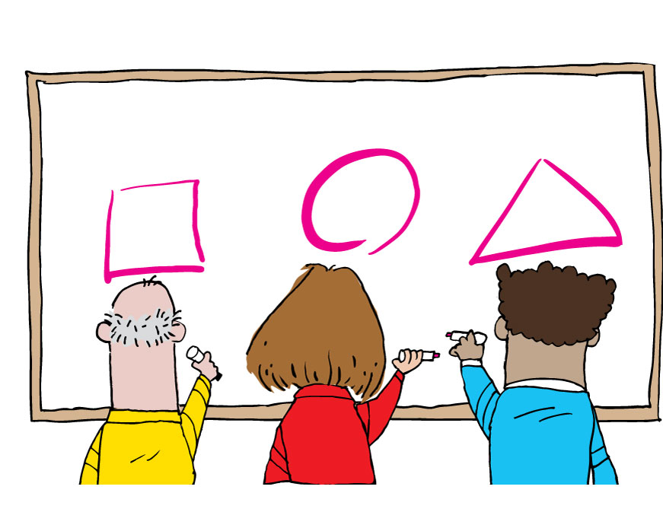
Mental Models
“Ah...”
Notes:
Use workshops & models throughout the project to
-----------------------------------------------------------------------------------
Then discuss that without models there is risk that folks are not on the same page. And that models are used throughout the project. Visioning, objectives, requirements gathering, process definition, etc. Models come in all forms.

Slide 25
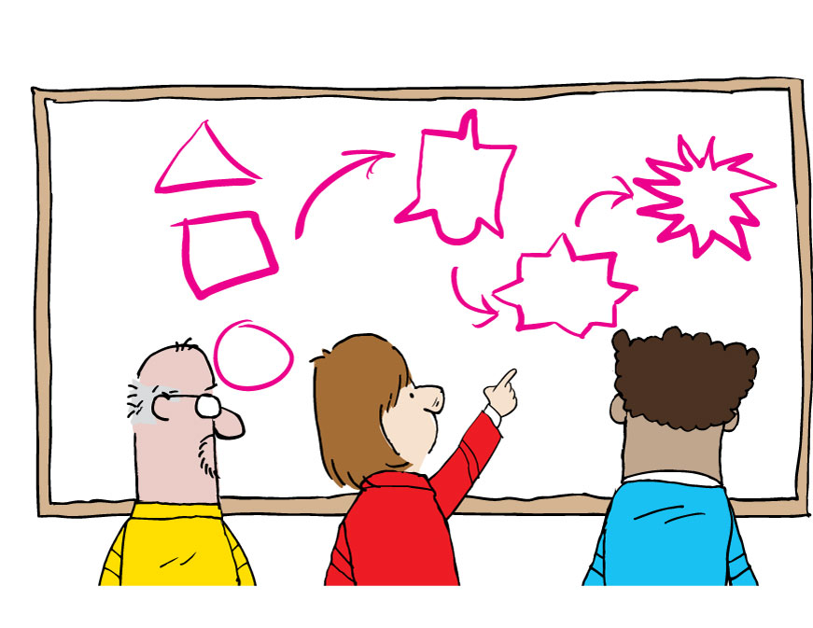
Convergence
“Ah!”
Notes:
An explicit model allows convergence through iteration
Through techniques we can converge the models to get to a common understanding

Slide 26
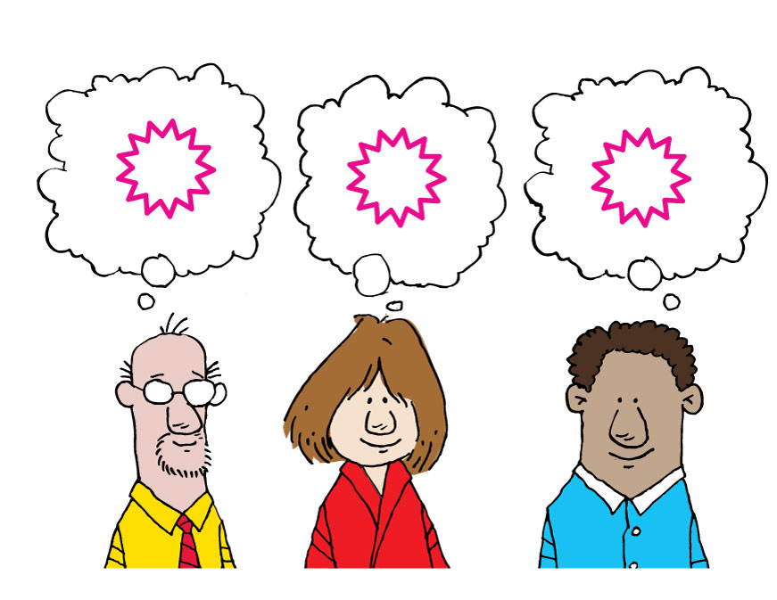
Shared understanding
“I’m glad we’re all agreed then.”

Slide 27
Agile In Basket
exercise
Split into groups
Look through your inboxes
Put each inbox item into the appropriate category
Prioritize requirements
Identify requirements
Clarify requirements
Represent requirements
Discuss results
Notes:
This activity is designed to assist you to become familiar with the artifacts produced by agile analysis, what they look like and what they might be used for.
Prepare 2/3 Inboxes with various artifacts (Prototypes, stories, BPM, Narratives etc)
Split the group into 3 sub groups and ask them to look through their inboxes.
Put up prepared flipcharts with the headings Identify requirements, Clarify requirements, Represent requirements.
Ask participants to attempt to work through the artifacts in their inbox and think about under which heading they may be used
Recall participant’s attention and discuss their responses, talk through any differing results and acknowledge their efforts.
REQUIRES PREP – must create the artifacts
Business objectives
High level scope document
Elevator pitch
Trade off sliders
Business case
Roles & Goals
Scenarios
Personae
Prototype
Story card
Narrative
Acceptance criteria
Story map
Span plan

Slide 28

Debrief
What went well?
What key learnings did you take from that exercise?
What still puzzles you?
Notes:
Debrief:
What went well?
What key learning's did you take from that exercise?
What still puzzles you?

Slide 29
Review
Analysis pain points
The Agile approach
Analyst responsibilities & tasks
A shared understanding
Activity

Slide 30
Questions?

